Slide 1

ECE 180- Signals And Systems
CA-3
Date- 19/11/2024
Submitted To-Dr. Parulpreet Singh
Submitted By-
Name | Reg. No | Roll No
Mohammad Sharique Arshad | 12310194 | 33
Anmol Vishnoi | 12311962 | 34
Sanjay Singh Chetri | 12324440 | 47
Akshat Shrivastav | 12311278 | 50

Slide 2

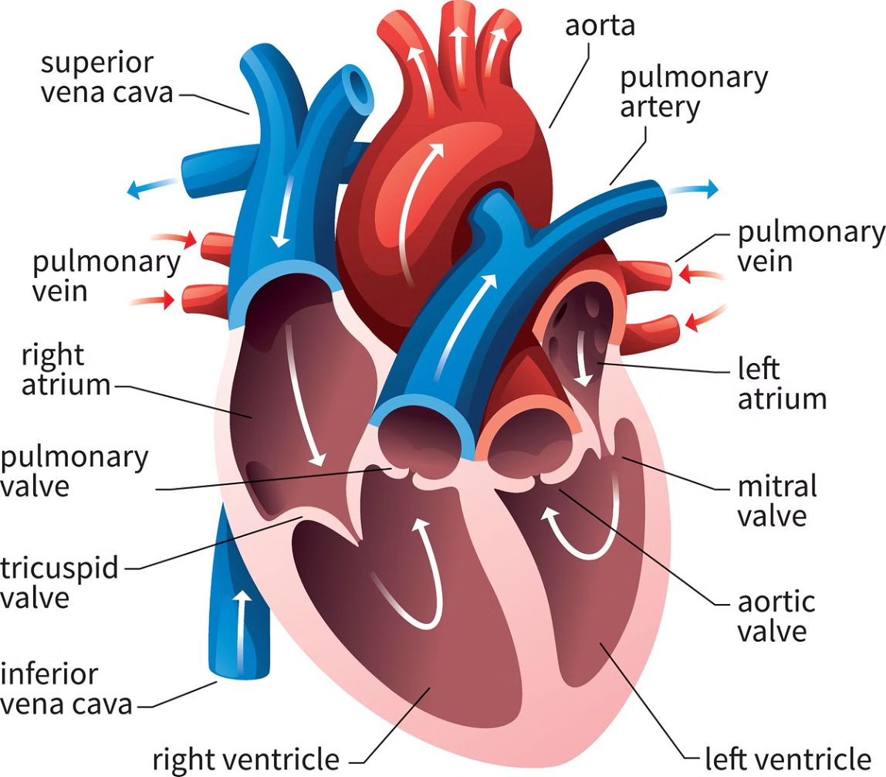
ECG Signal Generation and Analysis System: A Comprehensive Overview
This presentation provides a detailed exploration of our ECG signal generation and analysis system. We'll delve into its core components, functionalities, and potential impact on various fields, including medical education, clinical research, and industrial applications.

Slide 3
Understanding the ECG: Fundamentals and Challenges
ECG Basics
Modern Challenges
The Electrocardiogram (ECG) is a non-invasive test that measures the electrical activity of the heart. It's a cornerstone of cardiac diagnosis, capturing the heart's rhythm and electrical conduction patterns. The ECG waveform consists of distinct components, such as the P, Q, R, S, and T waves, each corresponding to specific electrical events within the heart.
Existing ECG simulation systems often lack accuracy and customization. There's a growing need for realistic ECG generation, particularly for training medical professionals and conducting research. These simulations must incorporate physiological variability and mimic real-world ECG patterns.

Slide 4
Significant features of ECG waveform:
A typical scalar electrocardiographic lead is shown in Figure, where the significant features of the waveform are the P, Q, R, S, and T waves, the duration of each wave, and certain time intervals such as the P-R, S-T, and Q-T intervals.
Main features of this simulator:
Any value of heart beat can be set
Any value of intervals between the peaks (ex-PR interval) can be set
Any value of amplitude can be set for each of the peaks
Fibrillation can be simulated
Noise due to the electrodes can be simulated
Heart pulse of the particular ECG wave form can be represented in a separate graph
Typical ECG signal

Slide 5
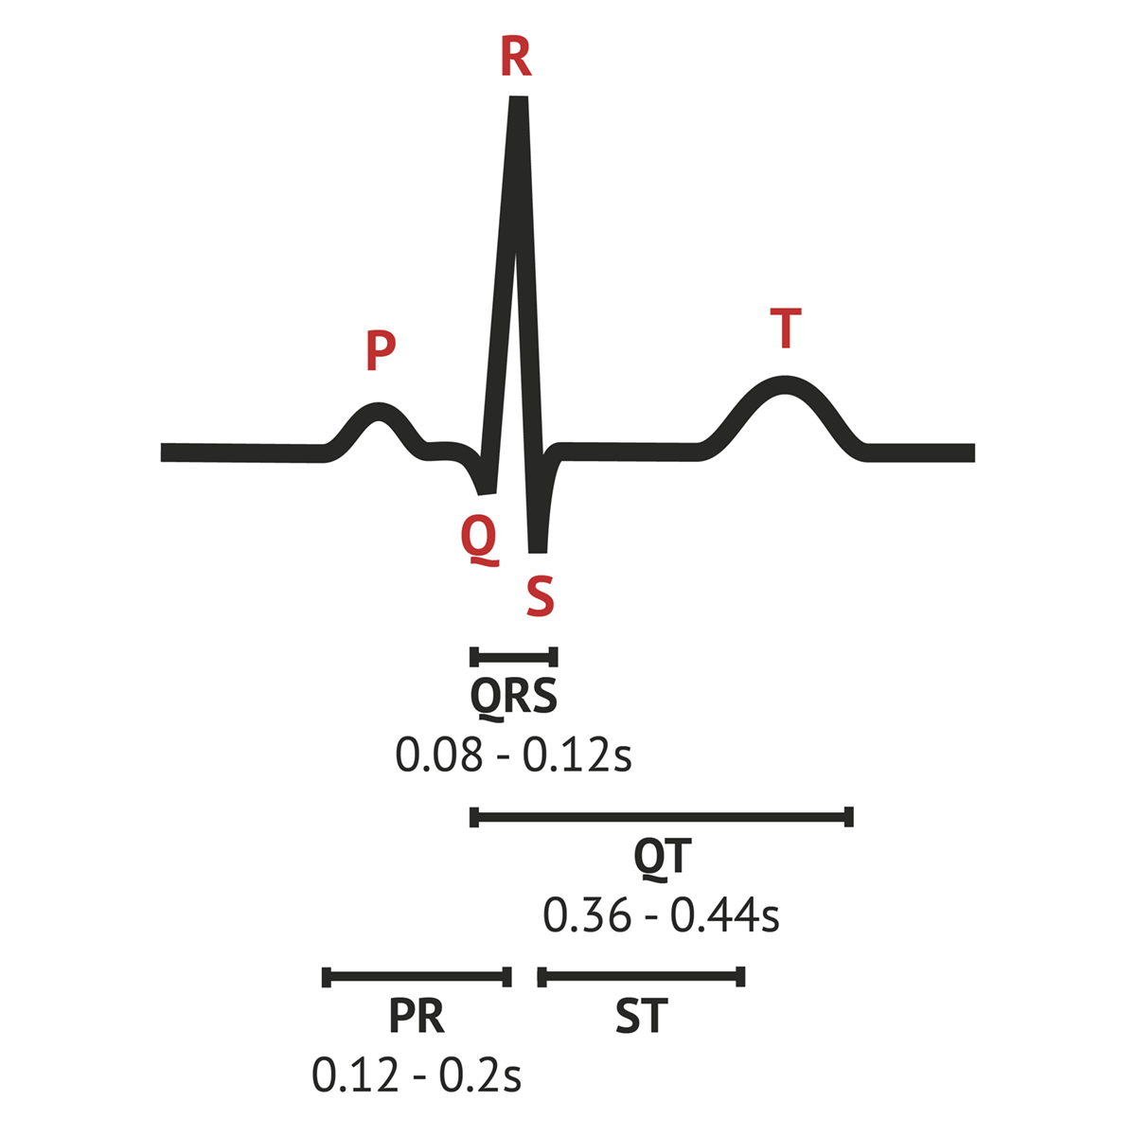
Normal ECG values for waves and intervals are as follows:
PR interval: 0.6-1.2 seconds
P wave: 80 milliseconds
PR interval: 120-200 milliseconds
PR segment: 50-120 milliseconds
QRS complex: 80-100 milliseconds
ST segment: 80-120 milliseconds
T wave: 160 milliseconds
QT interval: 420 milliseconds or less if heart rate is 60 beats per minute (bpm)

Slide 6
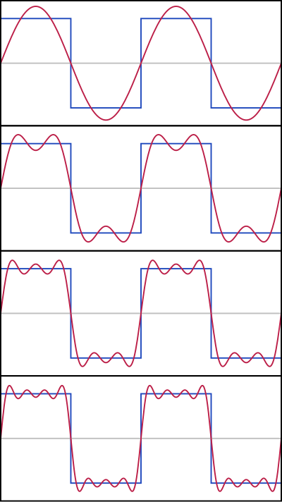
Principle:
Fourier series
Any periodic functions which satisfy dirichlet’s condition can be expressed as a series of scaled magnitudes of sin and cos terms of frequencies which occur as a multiple of fundamental frequency.
∞ ∞
f (x) = (a_{o}/2) + Σ a_{n} cos (nπx / l) + Σ b_{n} sin (nπx / l),
n=1 n=1
a_{o} = (1/ l ) ∫ f (x) dx , T = 2l --→ (1)
T
a_{n} = (1/ l ) ∫ f (x) cos (nπx / l) dx , n = 1,2,3…. --→ (2)
T
b_{n} = (1/ l ) ∫ f (x) sin (nπx / l) dx , n = 1,2,3…. --→ (3)
T

Slide 7
Code Implementation
% ECG Signal Generation and Analysis
clear;
close all;
clc;
% Time parameters
fs = 1000; % Sampling frequency (Hz)
T = 10; % Duration (s)
% Generate dynamic ECG signal
[ecg, t] = generate_dynamic_ecg(fs, T);
% Add baseline wander and noise to the ECG signal
ecg_noisy = add_noise(ecg, t);
% Filter noisy ECG signal using a bandpass Butterworth filter
ecg_filtered = filter_ecg(ecg_noisy, fs);
% Detect R-peaks and calculate heart rate
[hr_bpm, r_peaks] = calculate_heart_rate(ecg_filtered, fs);
% Plot the ECG signals
plot_ecg_signals(t, ecg_noisy, ecg_filtered, hr_bpm, r_peaks, fs);
% Display average heart rate
fprintf('Average heart rate: %.2f bpm\n', mean(hr_bpm));
% Generate dynamic ECG signal
function [ecg, t] = generate_dynamic_ecg(fs, T)
hr_min = 60; % Minimum heart rate (bpm)
hr_max = 100; % Maximum heart rate (bpm)
num_cycles = T * hr_min / 60; % Calculate the approximate number of cycles
t_hr = linspace(0, T, num_cycles); % Time vector for heart rate changes
hr = linspace(hr_min, hr_max, num_cycles); % Linearly interpolate heart rate between min and max
% Detect R-peaks and calculate heart rate
function [hr_bpm, r_peaks] = calculate_heart_rate(ecg_filtered, fs)
% Adjust threshold value if necessary
threshold = max(ecg_filtered) * 0.6; % Adjust threshold based on signal
[~, r_peaks] = findpeaks(ecg_filtered, 'MinPeakHeight', threshold, 'MinPeakDistance', 0.5*fs);
if length(r_peaks) > 1
hr_samples = diff(r_peaks); % Difference between R-peak locations in samples
hr_time = hr_samples / fs; % Convert to time (s)
hr_bpm = 60 ./ hr_time; % Convert to beats per minute (bpm)
else
hr_bpm = []; % If no R-peaks are detected, return an empty array
end
end
% Plot the ECG signals
function plot_ecg_signals(t, ecg_noisy, ecg_filtered, hr_bpm, r_peaks, fs)
figure;
subplot(3, 1, 1);
plot(t, ecg_noisy);
title('Noisy ECG Signal');
xlabel('Time (s)');
ylabel('Amplitude');
subplot(3, 1, 2);
plot(t, ecg_filtered);
hold on;
plot(r_peaks / fs, ecg_filtered(r_peaks), 'ro');
title('Filtered ECG Signal and R-Peaks');
xlabel('Time (s)');
ylabel('Amplitude');
subplot(3, 1, 3);
if ~isempty(hr_bpm)
plot(t(r_peaks(1:end-1)), hr_bpm);
end

Slide 8
Code Implementation
title('Heart Rate');
xlabel('Time (s)');
ylabel('BPM');
end
% Generate a single ECG cycle using parameters
function y = ecg_cycle_gen(t)
li = 30 / 72; % Default heart beat interval
% P wave
y = p_wav(t, 0.25, 0.09, 0.16, li);
% Q wave
y = y + q_wav(t, 0.025, 0.066, 0.166, li);
% QRS complex
y = y + qrs_wav(t, 1.6, 0.11, li);
% S wave
y = y + s_wav(t, 0.25, 0.066, 0.09, li);
% T wave
y = y + t_wav(t, 0.35, 0.142, 0.2, li);
% U wave
y = y + u_wav(t, 0.035, 0.0476, 0.433, li);
end
% Define wave functions
function y = p_wav(t, amplitude, duration, interval, li)
y = amplitude * exp(-((t - interval) / duration).^2);
end
function y = q_wav(t, amplitude, duration, interval, li)
y = -amplitude * exp(-((t - interval) / duration).^2);
end
function y = qrs_wav(t, amplitude, duration, li)
y = amplitude * exp(-((t - li/2) / duration).^2);
end
function y = s_wav(t, amplitude, duration, interval, li)
y = -amplitude * exp(-((t - interval) / duration).^2);
end
function y = t_wav(t, amplitude, duration, interval, li)
y = amplitude * exp(-((t - interval) / duration).^2);
end
function y = u_wav(t, amplitude, duration, interval, li)
y = amplitude * exp(-((t - interval) / duration).^2);
end

Slide 9
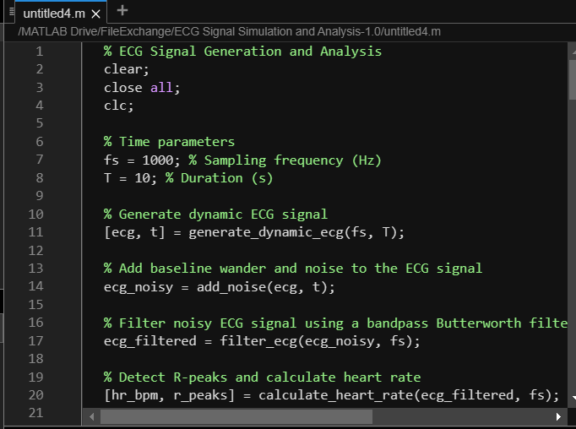
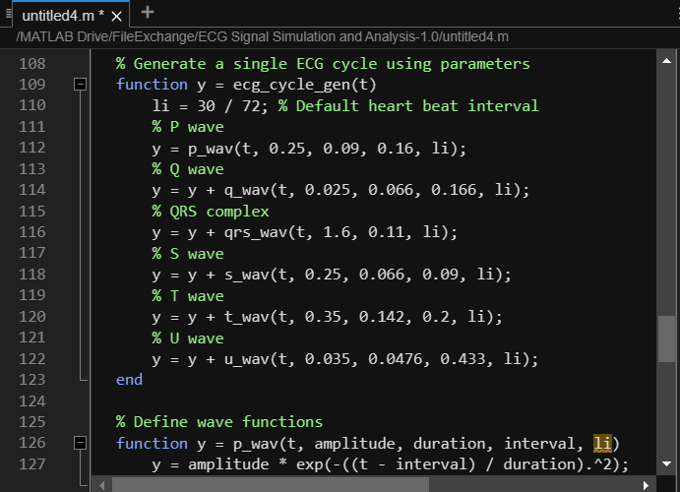
Code Implementation

Slide 10
Result Obtained
Default Specification for the `ecg_cycle_gen` Function
Heart Rate: 72 beats per minute (bpm)
Wave Amplitudes:
P wave: 0.25 mV
R wave: 1.60 mV
Q wave: 0.025 mV
T wave: 0.35 mV
Time Intervals:
P-R interval: 0.16 seconds
S-T interval: Approximately 0.18 seconds

Slide 11
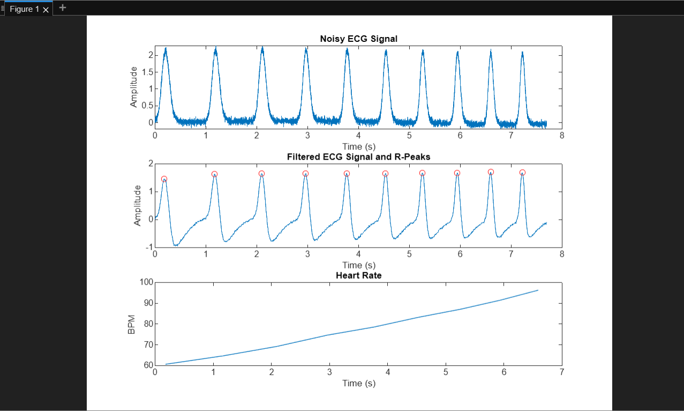
Result Obtained

Slide 12
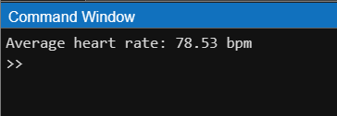
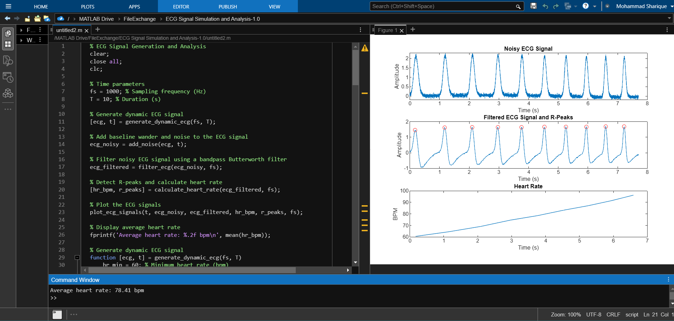
Result Obtained

Slide 13






System Architecture: A Robust Design
Signal Generator
Noise Simulation
The heart of the system is the signal generator module, responsible for producing realistic ECG waveforms based on user-defined parameters.
A dedicated noise simulation module introduces realistic noise patterns, mimicking real-world signal distortions and creating a more challenging environment for analysis.
Filter Module
Analysis Module
The filter module cleans the noisy ECG signal using advanced filtering techniques, such as Butterworth filtering, to enhance clarity and facilitate accurate analysis.
The analysis module processes the filtered ECG signal, extracting key features like heart rate, R-peak locations, and other relevant metrics, providing comprehensive insights into the simulated cardiac activity.

Slide 14
Real-Life Applications: Transforming Medical Training and Research
Medical Education
Clinical Research
Our system provides a valuable tool for medical students, allowing them to practice ECG interpretation and rhythm analysis in a safe and controlled environment. They can explore various heart conditions and develop critical decision-making skills.
Researchers can use our system to simulate different cardiac scenarios, study drug effects, or explore the impact of various interventions on the ECG, advancing our understanding of heart function and disease.

Slide 15


Industrial Applications: Driving Innovation in Healthcare Technology
1
Medical Device Industry
Device manufacturers can leverage our system for product development, testing, and validation. Our customizable ECG generation capabilities allow for rigorous testing and validation of ECG monitoring devices.
2
Healthcare Technology
Our system can be integrated into telemedicine platforms and mobile health applications, enabling remote patient monitoring, early detection of cardiac anomalies, and improved healthcare accessibility.

Slide 16


Benefits and Advantages: Enhancing Efficiency and Accuracy
Educational Benefits
Technical Benefits
Our system provides hands-on learning experiences for medical professionals, enabling them to practice ECG interpretation and analysis without the risks associated with real patients.
The system offers high accuracy, real-time analysis, and customizable parameters, ensuring robust and reliable ECG simulations that mimic real-world conditions.
Economic Benefits
Our system reduces training costs, improves diagnostic accuracy, and facilitates efficient device testing, contributing to cost-effective healthcare practices.

Slide 17






Future Enhancements: Pioneering the Future of ECG Technology
Machine Learning Integration
Integrating machine learning algorithms can further enhance the system's capabilities, enabling automatic ECG analysis, arrhythmia detection, and personalized patient monitoring.
Arrhythmia Simulation
Expanding the system to simulate various arrhythmias will provide invaluable training opportunities for medical professionals and researchers to understand and manage complex cardiac conditions.
Real-Time Data Streaming
Enabling real-time data streaming will facilitate dynamic ECG analysis, allowing for immediate insights into cardiac activity and potential interventions.
Cloud Integration
Integrating the system with cloud platforms will enhance data storage, accessibility, and collaborative research capabilities, fostering advancements in ECG technology.

